Slide 1
Why Alto HSR is not Sustainable in QC-Toronto Corridor: on cost or demand
Ian Lee, PhD
Sprott School of Business
Carleton University

Slide 2
3 Major HSR Research Sources
1. What Holds HSR Back: Lessons from Global Systems & California’s Experience, 2026
Deepak K Sharma, PhD Rajnish Lekhi, PhD Scott Parr, PhD, PE
2. The socio-economic impacts of high-speed rail: a cross-national comparative review, 2025
Xiuxin Ma, Anton Van Rompaey & Ben Derudder
3. Hyett, ALTO HSR Citizen Research Initiative: altohsrcitizenresearch.ca

Slide 3
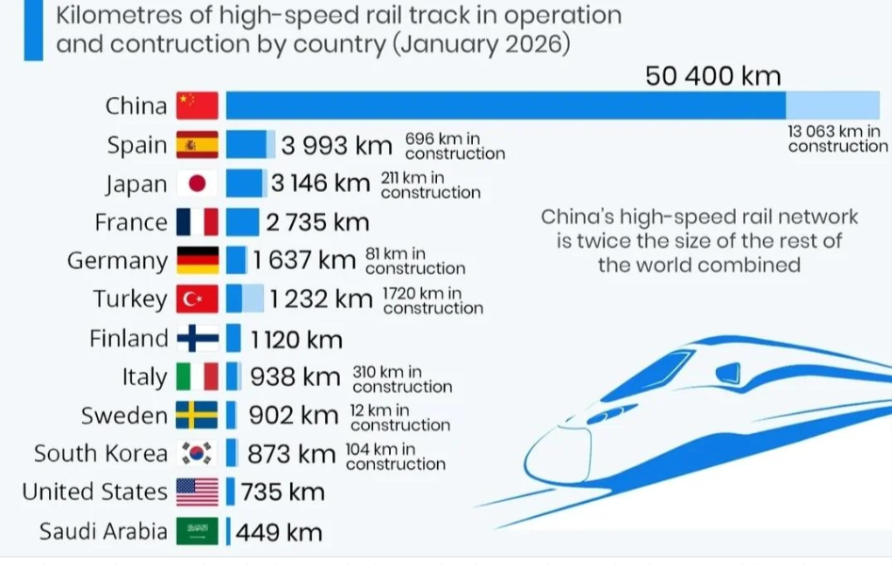
World’s Longest HSR networks

Slide 4
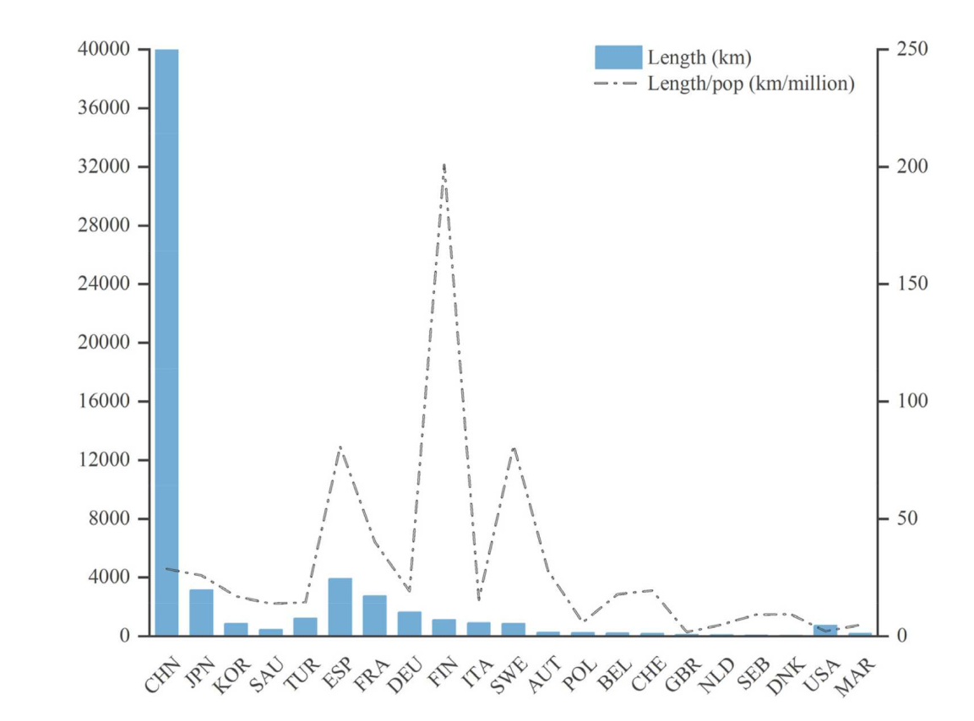
Global distribution of HSR by KM
China = 75% -85% of HSR in world

Slide 5
Impact of HSR in these 3 regions
China, HSR significantly boosted economic growth by facilitating agglomeration econ
18 mega cities +10 Million
20 Chinese cities +5 Million pop
HSR has reshaped labour mobility in China, expanding commuting distances to 100–200 km (travel time < 60 minutes

Slide 6
China Railway
Fixed-Asset Investment: Reached 440.6 billion yuan ($64.9 billion USD), July 2026
HSR 50,000 KM of 150,000 total CN KM
Total Debt: $1 trillion in USD
Overall Deficit: Roughly 80% of HSR operates at financial loss

Slide 7
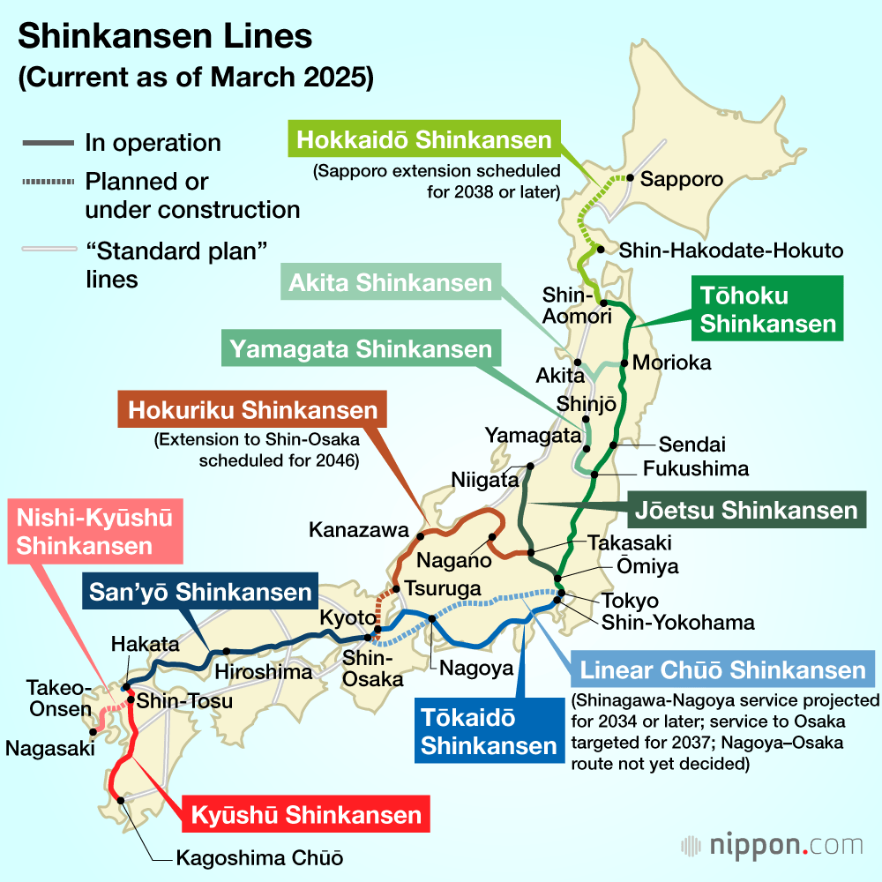
Japan, 9 Shinkansen lines
Japan is 150 KM wide x 3000 KM length w/ 122 Million pop

Slide 8
Population of Spain, Italy, France, Benelux
France: ~68 million
Italy: ~58.9 million
Spain: ~47.9 million
Benelux Countries
Netherlands: ~18.1 million to 18.4 million
Belgium: ~11.7 million
TOTAL: 204 MILLION population

Slide 9
Toal Square KM, France, Spain, Italy, Benelux
France: ~543,941 km²
Spain: ~505,983 km²
Italy: ~302,069 km²
Benelux Countries: ~74,964 km² combined
Netherlands: ~41,850 km²
Belgium: ~30,528 km²
Luxembourg: ~2,586 km²
TOTAL: 1.4 square KM

Slide 10
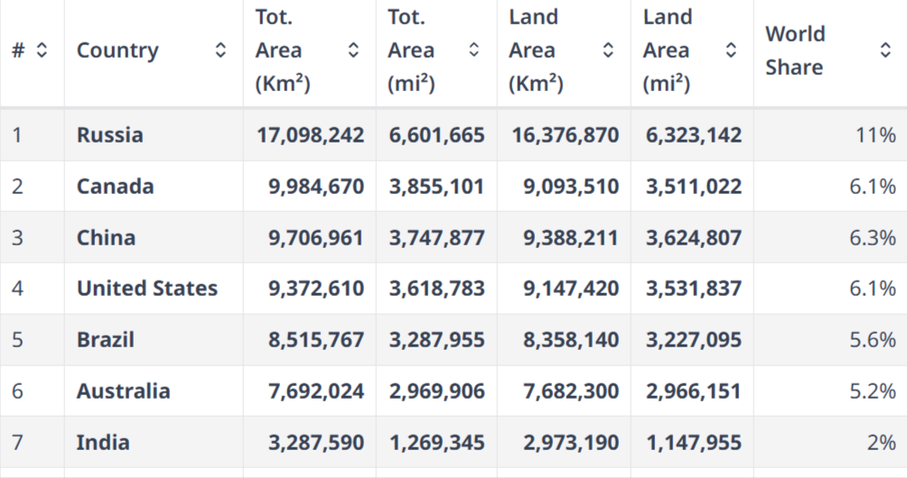
Land area: Cda, China, US same size

Slide 11
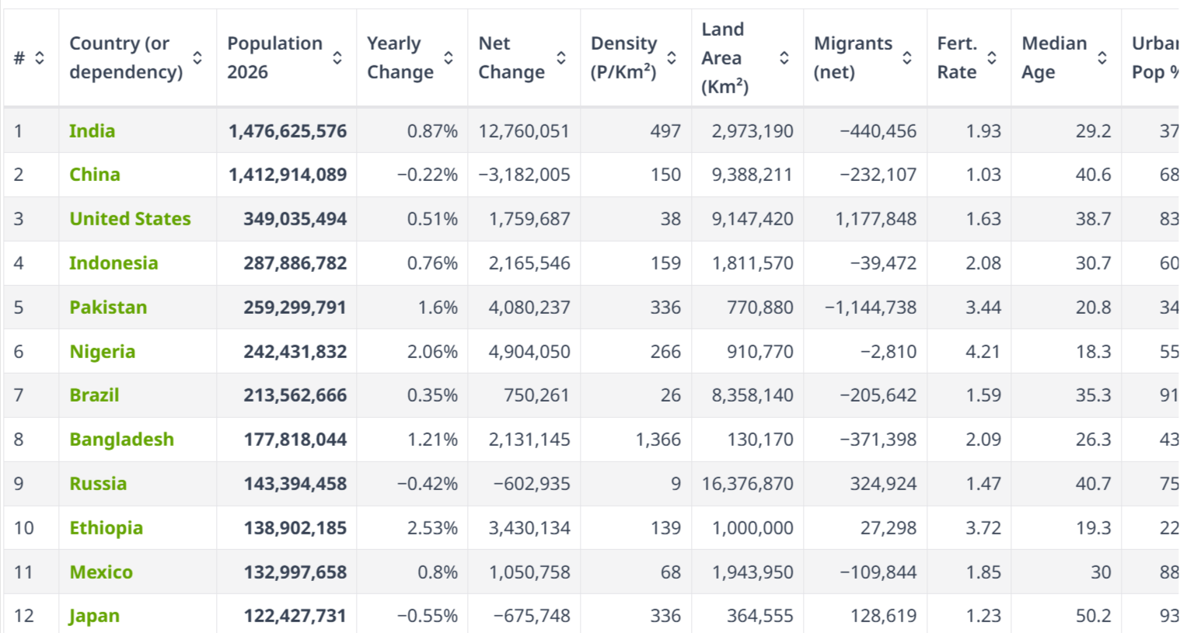
12 largest countries by pop – look at density per sq KM

Slide 12
Does population density reveal insights?
China has 1.4 BILLION people in 3rd largest geography – 150 per sq KM
Japan: 120 MILLION people in small geography: 336 per sq KM
EU has 500 MILLION people in mid size geography (4.2 M sq KM – CDA is 2.2X larger with 9.9 sq KM) : 110 per sq KM

Slide 13
Densities: China, Japan, EU – (& CDA)
China: 150 vs USA: 38 persons sq KM
Japan: 336 persons sq KM
EU: 110 persons per sq KM
Canada: 4.5 persons per sq KM
Much of CDA empty – so is China, US

Slide 14
Comparative HSR Costs by country or project

Slide 15
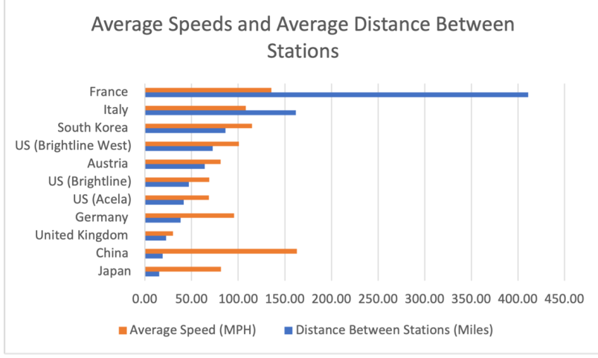
Sharma, F2: Comparison of HSRs – Avg Speeds & Avg Distances btwn stations, 2025

Slide 16
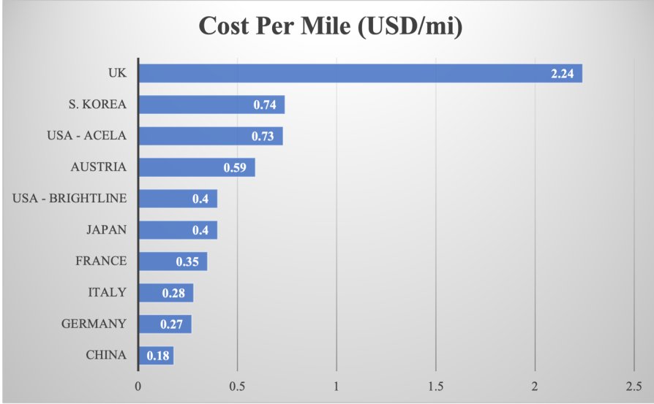
Sharma, F3: Comparison of passenger cost per mile for HSR, 2025

Slide 17
China, Auto, train, plane travel, 2024
Road / Auto Travel: Accounted for vast majority of trips growing by 3.3% to account 90.85% of total cross-regional movements
Train (Rail): 4.59 billion passenger trips, a 6.4% to 6.7% increase year-on-year, representing about 6.87% of overall cross-regional travel
Plane (Civil Aviation): approximately 1.53 billion passenger trips via civil transport airports/aviation channels, representing roughly 2.29% of total cross-regional travel

Slide 18
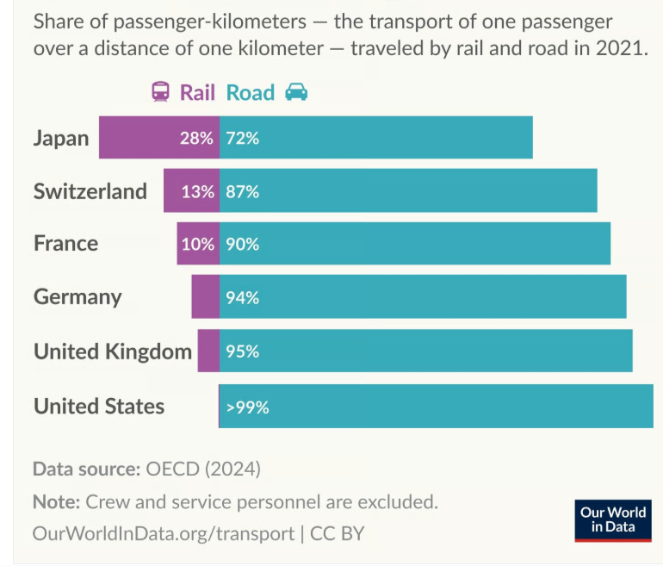
Train travel more common in Japan - 28% -than EU or China
After 50 years, billions $, high
densities, only 28% take train
– 72% use car

Slide 19
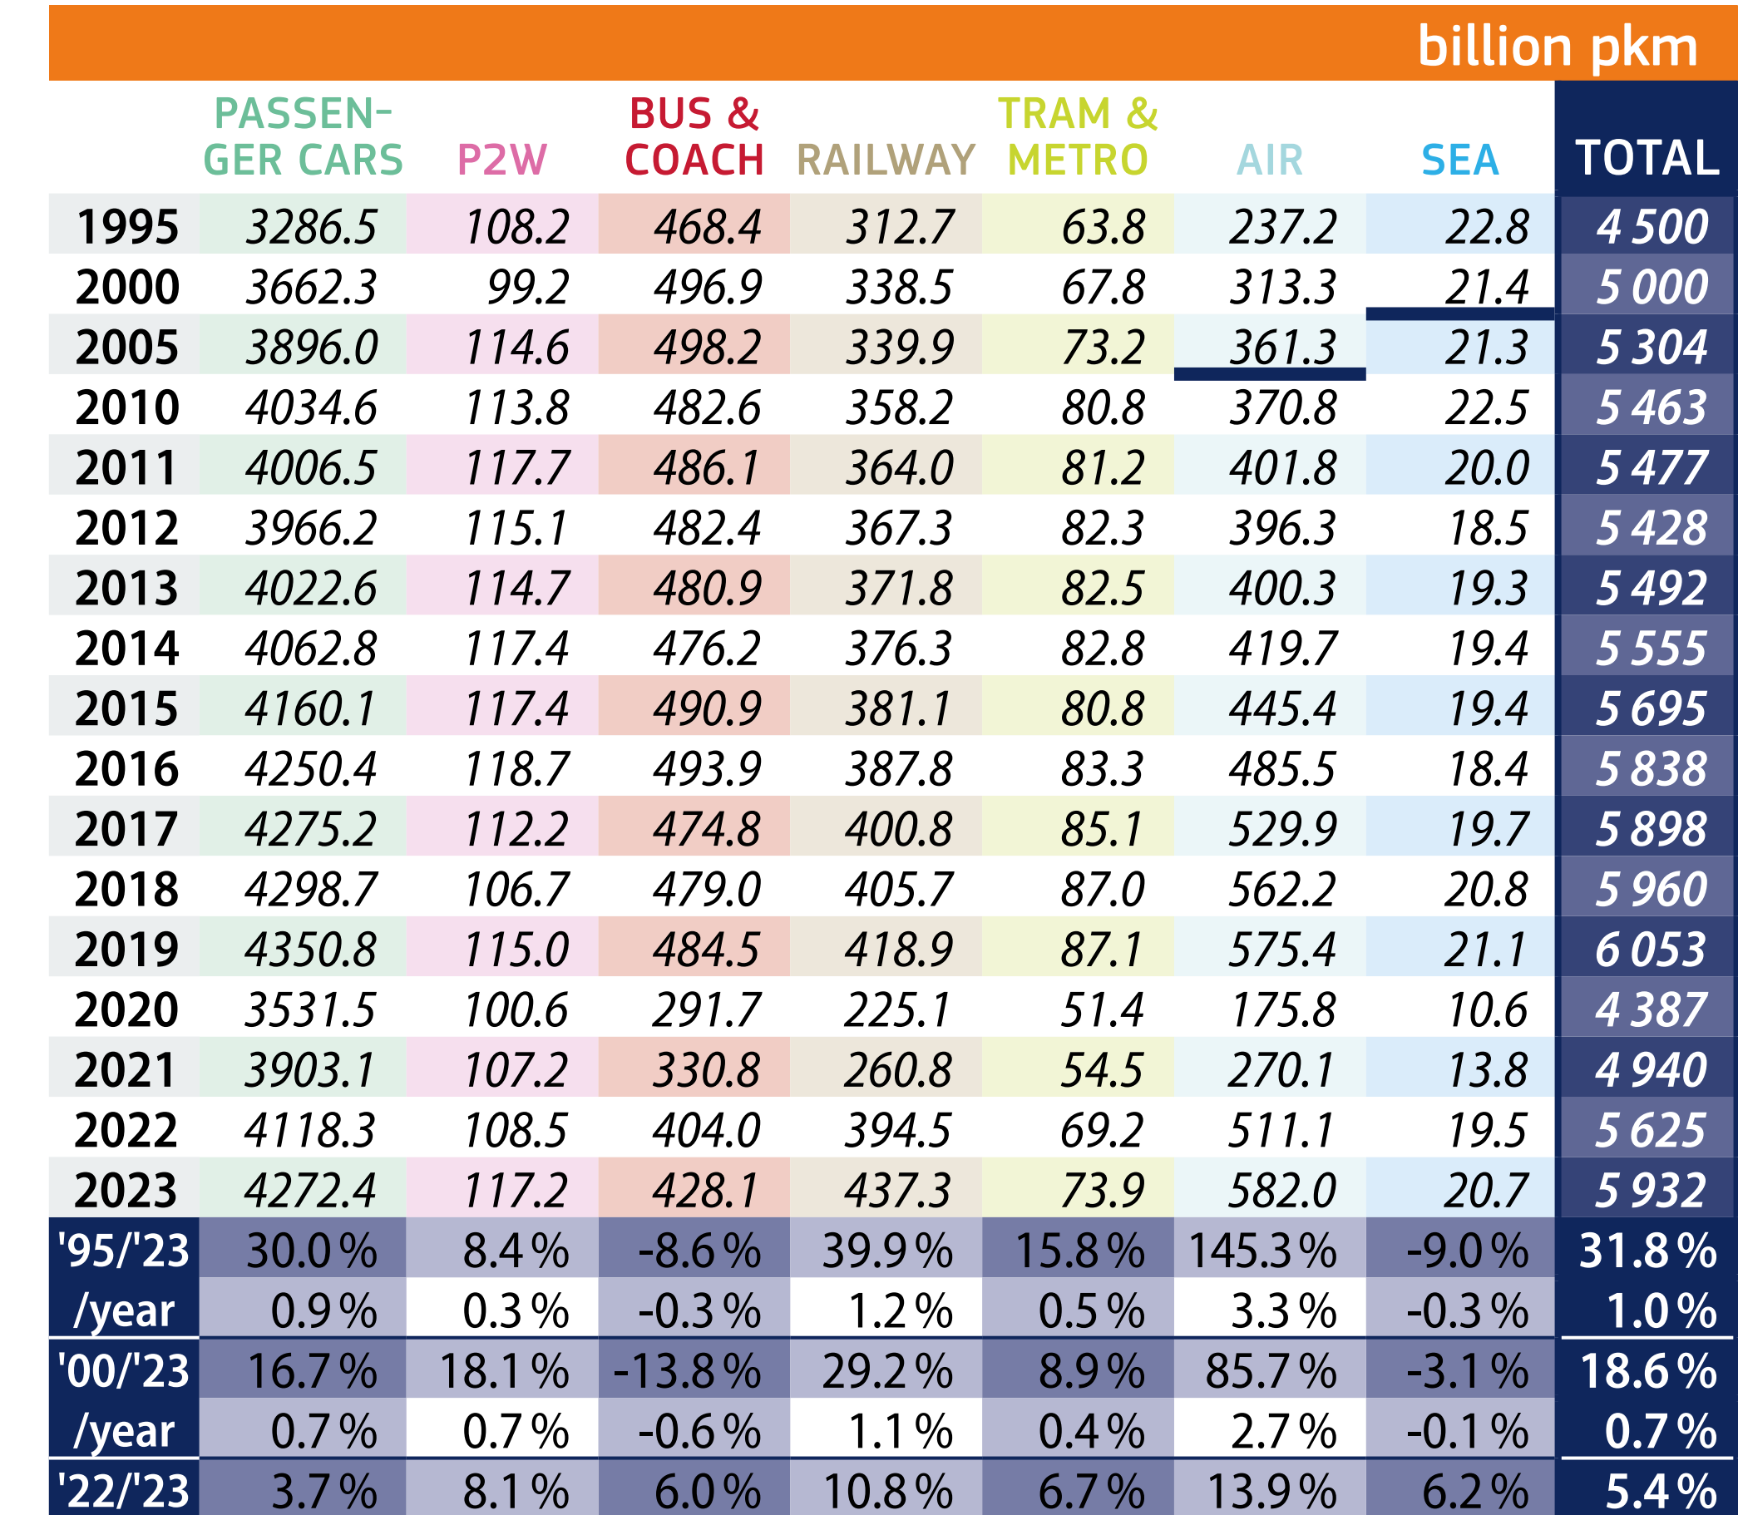
EU-27 Passenger Performance
BY MODE, 1995-2023
4.2 BILLION KM auto vs 437 M KM train in pkm or 10X

Slide 20
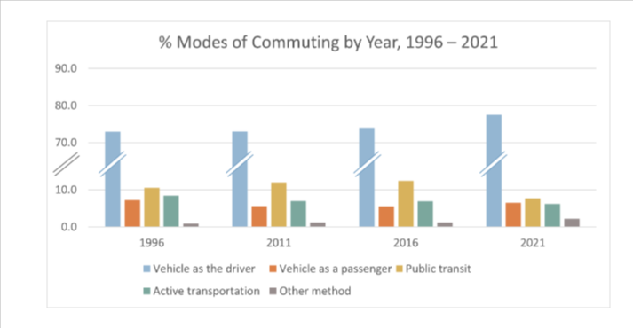
EU, Commuting by year, by transpo mode, 1996-2021
Same trend intra cities – cars used 10X more than public transit

Slide 21
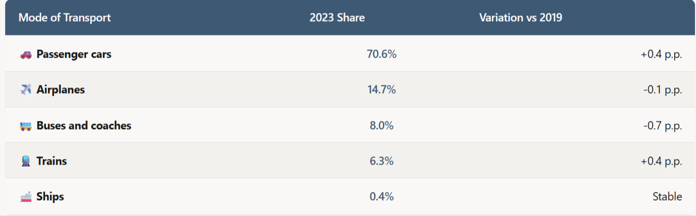
EU, Modal Split of Passenger Transport, 2019-2023
Autos used 10X more than trains – in green Europe!
https://www.studiocidadania.com/en/blog/transport-in-europe-2025-eurostat-mobility-study-brazilians

Slide 22
US BTS
Plane (Air Travel): Remains primary mode for long-distance journeys exceeding 750 miles or intercity travel
Distance: Cars dominate short-to-medium regional trips under 300 miles. Planes take over for long hauls
Trains compete primarily inside dense corridors like Northeast Corridor

Slide 23
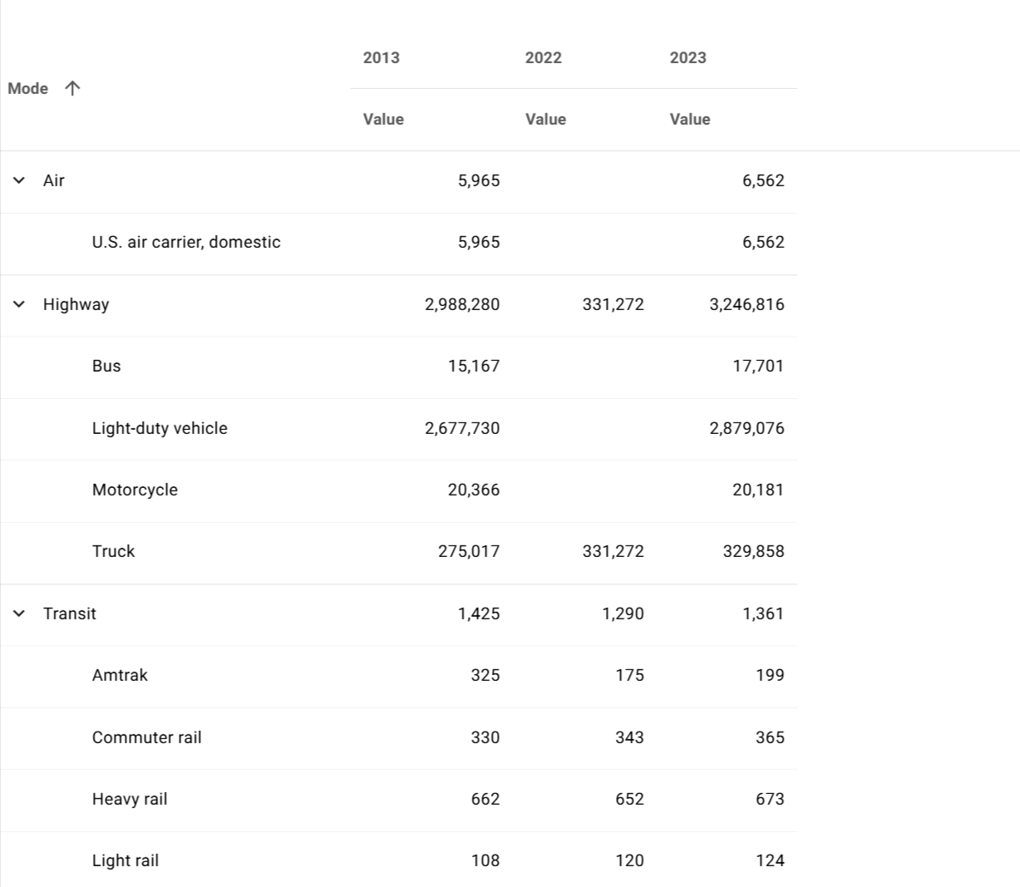
BTS, Aircraft, Vehicle, & Rail Car Miles of Travel, 2023
Autos used vastly more than train
https://data.bts.gov/stories/s/Moving-People/jyrm-py8x/

Slide 24
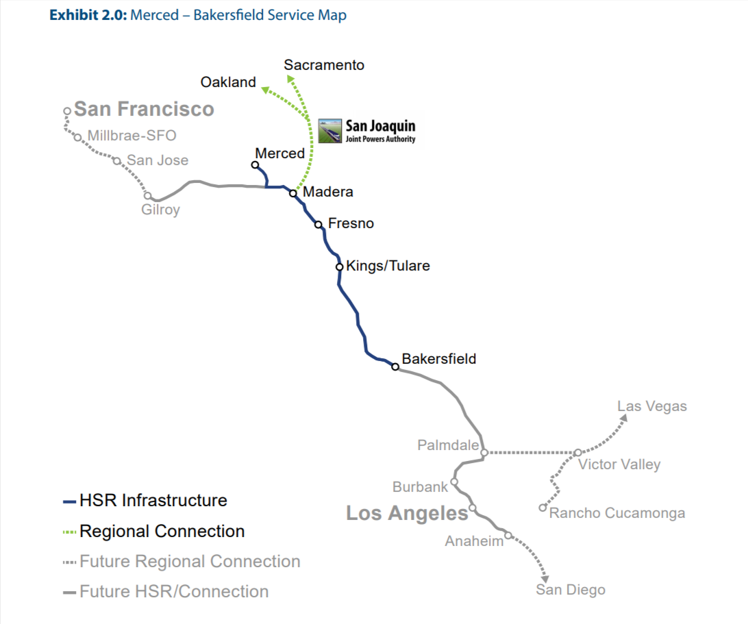
Map, Proposed HSR, LA to San Francisco
500 miles = 800 KM distance
Alto is 1000 KM from QC - TO

Slide 25
Cdn Demographic & Travel Stats:
QC to Toronto Corridor

Slide 26
Stats Can, Natl Travel Survey, 2024
Car / Road Trips: More than 50% to 86% of travel segments (depending on local daily trips or longer-distance travel)
Plane: Domestic air travel accounted for roughly 30% of long-distance leisure travel
Train / Public Transit: Trains and other non-auto/non-air transit make up very small fraction of overall travel nationally (typically under 2% to 4% of general trips)
https://www150.statcan.gc.ca/n1/daily-quotidien/250530/dq250530c-eng.htm

Slide 27
Stats Can, Key Urban Populations Along the QC-TO Corridor
Québec CMA: 857,697
Trois-Rivières CMA: 165,780
Montréal CMA: ~4.3 million+
Ottawa–Gatineau CMA: ~1.48 million
Kingston CMA: 184,150
Toronto CMA: 7,108,874
TOTAL: about 15 M Cdn pop in corridor

Slide 28
Stats Can, Quebec City language
QC is capital of Quebec
QC Pop: 600,000/850,000
96% French speaking – 50% work for Govt
How many QC Francophones travel to TO?

Slide 29
TO-MTL Air Passenger Counts
Estimated Volume: air corridor between Toronto (Pearson YYZ & Billy Bishop YTZ) & Montreal (Trudeau YUL)
between 2.5 million & 2.7 million passengers travel annually
Vastly BELOW Alto forecast of 24 M travellers annually

Slide 30
ALTO, Auto Travel Estimates for TO-MTL
Estimated Volume: Private cars are absolute dominant mode of transport along Highway 401, accounting for 5.5 million to 7 million annual trips
Corridor Share: Within broader regional corridor stretching from Windsor/Toronto to Quebec City, auto travel accounts for 97% of total regional trips
Alto forecasts most drivers stop driving

Slide 31
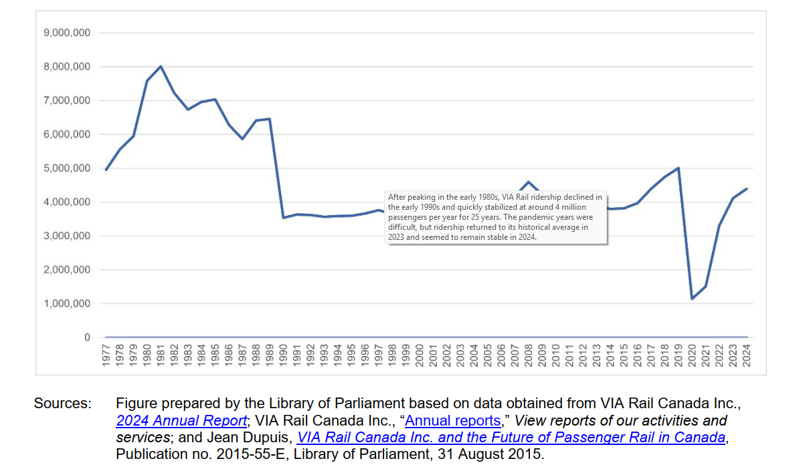
VIA Rail Annual Ridership, 1977-2024: 4-6 Million

Slide 32
Alto High Speed Rail

Slide 33
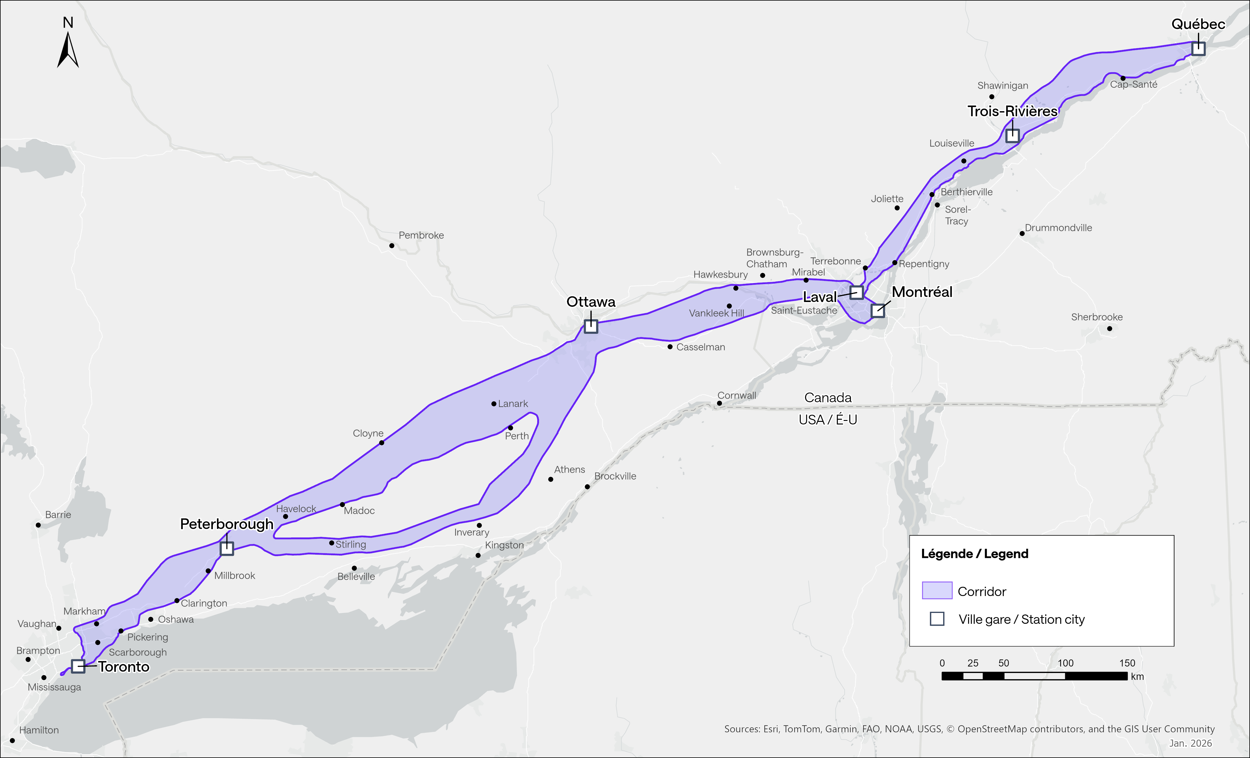
Alto HSR Proposal, 1000 Kilometer Distance
NB – 200 KM LONGER than California HSR
California forecasts $135 B (ie $200 B – CDN)
Altro claims $60 - $90 B - CDN

Slide 34
Map, Proposed HSR, LA to San Francisco
500 miles length – 800 KM
= forecast $135 Billion USD
High estimate is $250 B USD

Slide 35
Hyett, Overcoming Cdn Car Culture
Research using 2016 Census data found 67% of Canadians in major metro areas -
live in automobile suburbs, with a further 8% in even more car-dependent exurbs
Toronto and Montréal metro areas, the suburban share exceeds 80%

Slide 36
Hyett, Highway 401 reality
Highway 401 is corridor’s cultural & economic spine.
average of 442,900 vehicles pass thro one Toronto per day — busiest freeway in world
Statistics Can: suburban residents spend avg of 1 hour 23 minutes per day in their car,
& 81% make at least ONE car trip daily

Slide 37
Hyett, The last-mile problem
Toronto resident can reach 4.5 times as many jobs by car as by public transit in 30 minutes
Only 19% of employment is located in downtown Toronto
81% majority is scattered across suburban zones that are car-accessible but transit-inaccessible

Slide 38
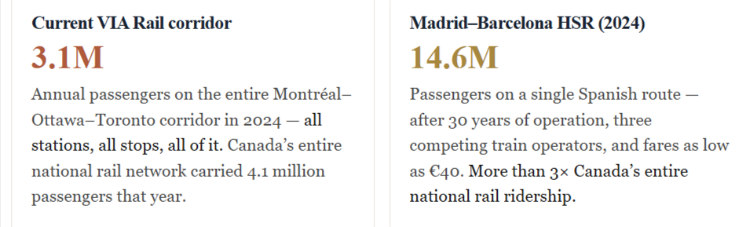
Hyett, Annual passengers: QC-TO vs Madrid-Barcelona
Alto forecasts 800% INCREASE from 3 Million to 24 million
passengers – on Alto train ONLY for +70% ALL travel trips

Slide 39
Hyett, How much intercity travel is there
Corridor’s total travel market is its population multiplied by number of intercity trips each resident makes on the routes the railway would serve
2025 corridor population at about 14.9 million across the cities directly served, growing at 1.0 per cent a year
= intercity travel at about 1.68 trips per resident per year

Slide 40
Alto claims 71% of all car-air-rail trips by 2055
20.1M people in QC-TO corridor in 2055
33.7M intercity trips a year in 2055, by every mode — car, air, bus and rail
20.1M × 1.68 trips each
= 71% Alto mkt share of all trips by rail
Japan only got to 25% of all trips by rail

Slide 41
Hyett, Citizen Research
ALTO promises three things at once:
24 million people year will ride new train
will save 9.3 billion hours of travel time, worth $49.5 billion
ticket sales will cover cost of running and maintaining the line

Slide 42
Hyett, Citizen Research
All three depend on one number the report never gives: the price of ticket.
Cheap tickets fill trains, which is what the first two promises need
Expensive tickets bring in the revenue the third promise needs.
A fare cannot be cheap and expensive at same time, so three promises pull against one another.

Slide 43
Hyett, Citizen Research
single fare at which all three hold
about 19 cents per kilometre travelled — roughly $83 for a typical 428-KM journey.
At that price, ALTO breaks even only if 24 million people ride it, and 24 million people ride it only if the corridor is generating about 74 million intercity trips a year, by all modes
On ALTO’s own pop Numbers, corridor will generate about 34 million

Slide 44
Hyett, Alto promises can NOT be met
So making all three promises at once means making a fourth one that is never stated:
by 2055 the corridor would have to be generating more than twice the intercity travel that ALTO’s own population figures produce
Nobody forecasts travel on that scale
that is the problem

Slide 45
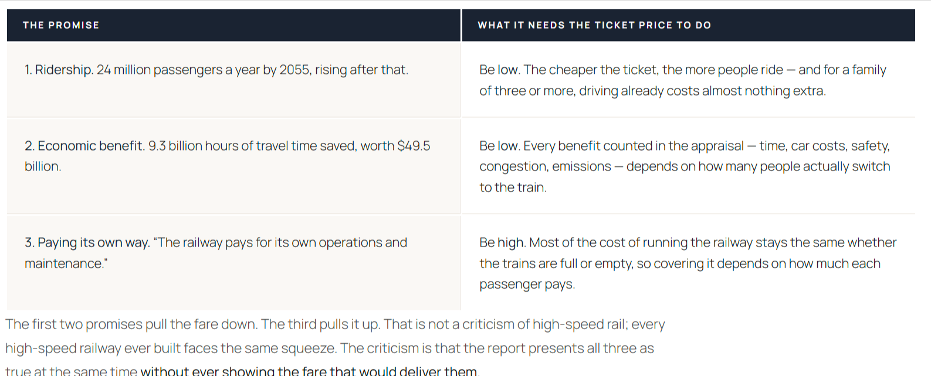
Hyett, Ridership, benefits & costs

Slide 46
Autonomous Vehicles
Emerging KILLER Technology
In Canada, US, EU & Asia

Slide 47
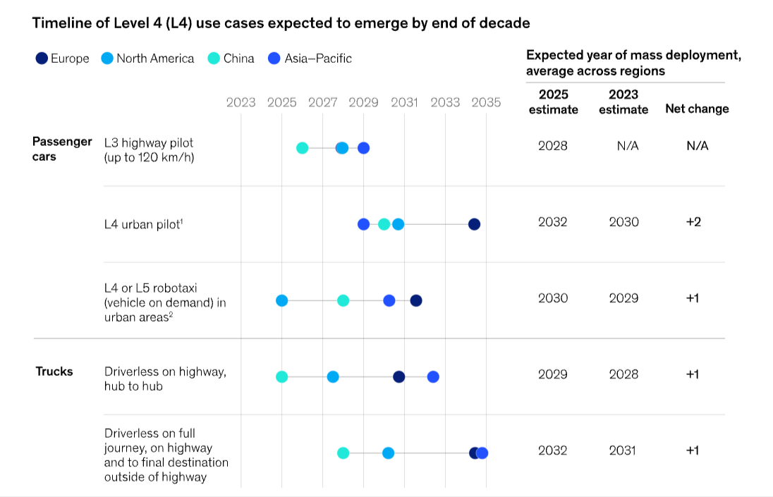
McKinsey, Forecast adoption of AV
https://www.mckinsey.com.br/features/mckinsey-center-for-future-mobility/our-insights/future-of-autonomous-vehicles-industry

Slide 48
Elon Musk
Near-Term Rollout: Musk stated that driverless vehicles operating in parts of Texas will expand nationwide
Long-Term Outlook: predicts that within a decade, about 90% of all travel distance will be handled by artificial intelligence in self-driving vehicles
Human Driving: Human driving is projected to become a rare activity as autonomous tech scale

Slide 49
Summary and Conclusion

Slide 50
HSR
1. HSR is horrendously capital intensive
2. requires large pops per China, Japan & EU
3. Requires high densities
4. NO HSR more than 10% of total travel passenger travel mkt in each country X Japan

Slide 51
Canada
Very small population along corridor
No culture of mass train travel
Mass reliance on auto since WWII
Highway 401 & Pearson, Bishop & Trudeau Airports very efficient

Slide 52
Hyett Conclusion
Every HSR operating scenario requires a permanent public subsidy
24-million-passengers-by-2055 figure cited in ALTO plan
not reproducible under any combo of fare, demographics, modal-shift assumptions

Slide 53
Hyett Conclusion
slower, dedicated line delivers most of benefit at quarter of cost
High Performance Rail (HPR) alternative, a dedicated, electrified 200 km/h corridor
about $28 M per KM, roughly $28 billion
fivefold cost gap between ALTO & HPR

